Slide 1
POLICE RECORDED CRIME STATISTICS
REPUBLIC OF SOUTH AFRICA
Fourth Quarter of 2023-2024 Financial year
(January 2024 to March 2024)
Compiled by:
Crime Registrar Head Office
Telephone: 012 360 1056/78

Slide 2
Table of contents
Crime statistics analysis
  National crime overview
  Trend & Provincial contributions / TOP30 contributing stations
      17 community reported serious crimes
      Contact crimes
        Murder
        Rape
        TRIO crimes
          Carjacking
          Robbery at residential premises
          Robbery at non-residential premises
        Robbery of cash in transit
        Truck hijacking
      Kidnapping
      Burglary non-residential premises (educational-, liquor outlet - & religious premises)
      Core diversions
      Provincial crime overview: summary

Slide 3
Republic of South Africa
Crime situation

Slide 4
Republic of South Africa
Selected contact crime: per ratio
PER CAPITA (*RATIO PER 100 000 OF THE POPULATION). MID-YEAR POPULATION ESTIMATES, 2021 SERIES

Slide 5
Republic of South Africa
Crime situation…continue

Slide 6
17 community-reported serious crimes
Trend over three-months period

Slide 7
17 community-reported serious crimes
TOP 30 stations

Slide 8
Contact crime
Contact crime refers to crimes in which the victims are the targets of violence or instances where the victims are in the vicinity of property that criminals target and are subjected to the use of/or threats of violence by perpetrators.
Murder
Rape
Some subcategories of robbery aggravating
  Carjacking
  Robbery at non-residential premises
  Robbery at residential premises
  Robbery of cash in transit
  Truck Hijacking
TRIO crimes

Slide 9
Contact crime
Trend over three-months period

Slide 10
Contact crime
TOP 30 stations

Slide 11
Selected causative factors
Murder, Attempted murder and Assault GBH - January 2024 to March 2024
Causative factors | Murder | Attempted murder | Assault GBH
Arguments/ Misunderstanding/ Road Rage / Provocation | 1 042 | 1 553 | 24 102
Vigilantism/ Mob justice | 410 | 57 | 409
Robbery | 386 | 971 | 494
Retaliation/ Revenge/ Punishment | 216 | 287 | 2 013
Gang-related | 214 | 328 | 16
Taxi-related | 114 | 61 | 11
Hijacking and attempts | 54 | 232 | 20
During commission of other crimes (not robbery or rape) | 38 | 143 | 438
Illicit mining | 26 | 5 | 0
Intervention in an argument | 22 | 108 | 1 124
Law enforcement & security guards in the line of duty (excl. police murder) | 22 | 105 | 35
Rape-related | 21 | 23 | 115
Sample size: murder = 6 225, attempted murder = 6 938, assault GBH = 35 449 counts

Slide 12
Selected Place of occurrence
Murder, Attempted murder and Assault GBH - January 2024 to March 2024
Place of occurrence | Murder | Attempted murder | Assault GBH
Public place e.g. street/open field/recreational centre/park/beach/parking area/abandoned building | 3 296 | 2 997 | 11 060
Residences of perpetrator/victim (including residence known by victims/ perpetrator e.g. family/friends/neighbours) | 1 677 | 2 175 | 16 164
Mode of Transport e.g. bus/car/plane/boat/ship/taxi | 235 | 613 | 170
Liquor outlets e.g. shebeen/tavern/pub/night club/bottle store | 228 | 350 | 3 499
Agricultural land/farm/plot/small holding | 143 | 86 | 436
Dumping site/refuse site | 140 | 4 | 22
Spaza/Tuck shop | 82 | 204 | 526
Business premises (e.g. mall/restaurants/work place/office park/entertainment centre e.g. movie theatre, gambling facility) | 77 | 168 | 709
Public transport premises (bus stop/taxi rank, railway premises e.g. track/station) | 59 | 52 | 203
Sea/river/lake/pool/dam | 31 | 10 | 22
Mining area | 13 | 13 | 5
Leisure premises e.g. hotel/guest house/bnb/motel/holiday resort | 11 | 12 | 36
Prison/Holding cells | 10 | 6 | 62
Petrol station | 9 | 37 | 107
Educational institutions (schools, universities, college, day care facilities) | 7 | 27 | 255
Sample size: murder = 6 225, attempted murder = 6 938, assault GBH = 35 449 counts

Slide 13
Selected contact crimes against women and children
Murder, Attempted murder and Assault GBH

Slide 14
Murder
Trend over three-months period

Slide 15
Murder
Per ratio: Provincial distribution (January to March)
PER CAPITA (*RATIO PER 100 000 OF THE POPULATION). MID-YEAR POPULATION ESTIMATES, 2021 SERIES

Slide 16
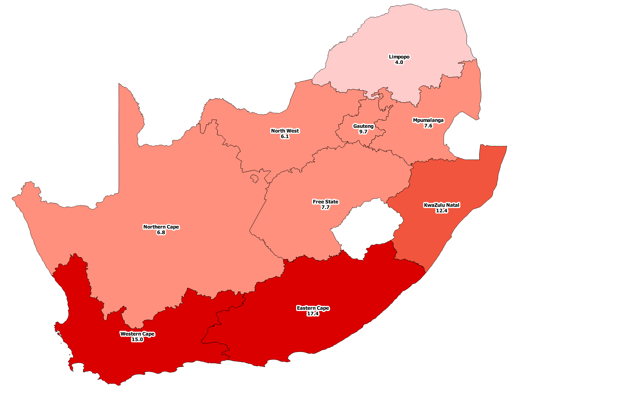

Murder
Per ratio: Provincial distribution (January 2024 to March 2024)
Province murder ratio
0 - 4
5 - 9
10 - 14
15 - 19
PER CAPITA (*RATIO PER 100 000 OF THE POPULATION). MID-YEAR POPULATION ESTIMATES, 2021 SERIES

Slide 17
Murder
TOP 30 stations

Slide 18
Murder: provincial distribution causative factors
January 2024 to March 2024
Causative factors | EC | FS | GP | KZN | LP | MP | NW | NC | WC | RSA
Arguments/ Misunderstanding/ Road Rage / Provocation | 253 | 32 | 121 | 232 | 58 | 16 | 58 | 37 | 235 | 1 042
Vigilantism/ Mob justice | 78 | 9 | 90 | 74 | 37 | 39 | 20 | 1 | 62 | 410
Robbery | 25 | 10 | 111 | 91 | 14 | 10 | 17 | 3 | 105 | 386
Retaliation/ Revenge/ Punishment | 11 | 2 | 21 | 56 | 4 | 2 | 7 | 1 | 112 | 216
Gang-related | 7 | 0 | 9 | 0 | 0 | 0 | 0 | 0 | 198 | 214
Taxi-related | 11 | 0 | 45 | 15 | 4 | 0 | 0 | 0 | 39 | 114
Hijacking and attempts | 4 | 2 | 25 | 6 | 2 | 4 | 1 | 0 | 10 | 54
During commission of other crimes (not robbery or rape) | 1 | 3 | 7 | 4 | 4 | 1 | 2 | 0 | 16 | 38
Illicit mining | 0 | 0 | 26 | 0 | 0 | 0 | 0 | 0 | 0 | 26
Intervention in an argument | 4 | 2 | 1 | 5 | 1 | 0 | 1 | 1 | 7 | 22
Law enforcement & security guards in the line of duty (excl. police murder) | 1 | 2 | 4 | 6 | 0 | 0 | 0 | 0 | 9 | 22
Rape-related | 4 | 0 | 2 | 3 | 5 | 0 | 1 | 0 | 5 | 20
Sample size: murder = 6 225 counts

Slide 19
Murder: provincial distribution Place of occurrence
January 2024 to March 2024
Place of occurrence | EC | FS | GP | KZN | LP | MP | NW | NC | WC | RSA
Public place e.g. street/open field/recreational centre/park/beach/parking area/abandoned building | 559 | 102 | 915 | 643 | 106 | 160 | 103 | 38 | 670 | 3 296
Residences of perpetrator/victim (including residence known by victims/ perpetrator e.g. family/friends/neighbours) | 333 | 70 | 356 | 421 | 63 | 64 | 79 | 35 | 256 | 1 677
Mode of transport e.g. bus/car/plane/boat/ship/taxi | 21 | 1 | 29 | 88 | 7 | 14 | 12 | 0 | 63 | 235
Liquor outlets e.g. shebeen/tavern/pub/night club/bottle store | 54 | 10 | 52 | 36 | 22 | 22 | 17 | 1 | 14 | 228
Agricultural land/farm/plot/small holding | 62 | 18 | 10 | 8 | 8 | 5 | 4 | 7 | 21 | 143
Dumping site/refuse site | 2 | 0 | 6 | 129 | 0 | 0 | 1 | 1 | 1 | 140
Spaza/Tuck shop | 1 | 2 | 17 | 21 | 6 | 2 | 8 | 1 | 24 | 82
Business premises (e.g. mall/restaurants/work place/office park/entertainment centre e.g. movie theatre, gambling facility) | 17 | 0 | 22 | 20 | 5 | 10 | 3 | 0 | 0 | 77
Public transport premises (Bus stop/taxi rank, railway premises e.g. track/station) | 2 | 0 | 21 | 11 | 1 | 4 | 5 | 1 | 14 | 59
Sea/river/lake/pool/dam | 7 | 4 | 3 | 8 | 2 | 2 | 1 | 0 | 4 | 31
Leisure premises e.g. hotel/guest house/bnb/motel/holiday resort | 0 | 0 | 2 | 6 | 0 | 1 | 1 | 0 | 1 | 11
Prison/holding cells | 0 | 1 | 1 | 1 | 2 | 2 | 0 | 1 | 2 | 10
Educational institutions (schools, universities, college, day care facilities) | 0 | 1 | 1 | 5 | 0 | 0 | 0 | 0 | 0 | 7
Abandoned building | 0 | 0 | 2 | 2 | 1 | 0 | 0 | 0 | 1 | 6
Sample size: murder = 6 225 counts

Slide 20
Causative factors for cases with five and more counts
January 2024 to March 2024
Circumstance/causative factors | Number of victims | Station | Other crimes committed
Taxi-related: unknown gunmen opened fire at the occupants of a house, five died on the scene, while other five were admitted to the hospital and another two succumbed to the injuries. | 7 x victims | Hout bay | 3 x attempted murder
Illegal mining relate: six Lesotho nationals involved in illegal mining were stoned to death allegedly by fellow zama-zamas. | 6 x victims | Roodepoort
Possible illegal mining relate: six bodies were found with gunshot wounds on the open veld, it is suspected that the incident is linked to an ongoing feud over illegal mining territory. | 6 x victims | Florida
Vigilantism/mob justice related: five people were stoned to death by community members | 5 x victims | Tembisa South | 1 x attempted murder
Mass killing: five bodies of an 85 year old woman, her daughter and three grand children were found hacked by an axe by a family member. | 5 x victims | Plessislaer
Mass shooting: three suspects entered the house and opened fire. Five people died at the scene and the fifth one died on the way to the hospital. | 5 x victims | Ulundi

Slide 21
Murder: Frequently used instrument
January 2024 to March 2024
 | EC | FS | GP | KZN | LP | MP | NW | NC | WC | RSA
Firearm | 447 | 51 | 817 | 774 | 64 | 129 | 75 | 3 | 586 | 2 946
Knives | 211 | 70 | 154 | 164 | 25 | 28 | 57 | 41 | 212 | 962
Sharp Instrument | 108 | 35 | 71 | 105 | 28 | 19 | 23 | 6 | 82 | 477
Blunt Instrument | 61 | 12 | 20 | 47 | 7 | 7 | 7 | 4 | 14 | 179
Body part | 23 | 16 | 39 | 18 | 12 | 11 | 13 | 1 | 16 | 149
Stone/ Brick/ Rock | 25 | 3 | 36 | 9 | 11 | 3 | 3 | 2 | 26 | 118
Sample size: murder = = 6 225 counts

Slide 22
Murder of members of the police
On/Off duty members / Trend over three-month period
10 off duty
2 on duty
7 off duty
1 on duty
7 off duty
2 on duty
5 off duty
3 on duty
4 off duty
2 on duty
4 off duty
0 on duty
_

Slide 23
Attacks on rural communities
Incidents reported during the three months
_

Slide 24
Murder of farming community
Victim linked to farm/small holding
 | EC | FS | GP | KZN | LP | MP | NW | NC | WC | RSA
Employee | 0 | 2 | 0 | 0 | 0 | 0 | 0 | 0 | 0 | 2
Farmer | 0 | 0 | 0 | 0 | 0 | 0 | 0 | 1 | 0 | 1
Farm Dweller | 0 | 2 | 0 | 0 | 1 | 0 | 0 | 0 | 0 | 3
Visitor | 0 | 1 | 0 | 0 | 0 | 0 | 0 | 0 | 0 | 1
Total | 0 | 5 | 0 | 0 | 1 | 0 | 0 | 1 | 0 | 7
_

Slide 25
Rape
Trend over three-months period

Slide 26
Rape
TOP 30 stations

Slide 27
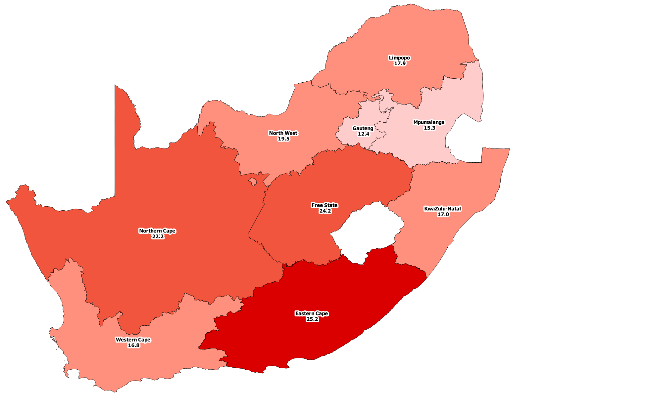
Rape
Per ratio: Provincial distribution (January 2024 to March 2024)
Province
rape ratio
10 - 15
16 - 20
21 - 24
25 - 30
PER CAPITA (*RATIO PER 100 000 OF THE POPULATION). MID-YEAR POPULATION ESTIMATES, 2021 SERIES

Slide 28
Rape: provincial distribution Place of occurrence
January 2024 to March 2024
Place of occurrence | EC | FS | GP | KZN | LP | MP | NW | NC | WC | RSA
Residences of perpetrator/victim (including residence known by victims/perpetrator e.g. family/friends/neighbours) | 790 | 367 | 803 | 937 | 493 | 296 | 340 | 202 | 688 | 4 916
Public place e.g. street/open field/recreational centre/park/parking area/abandoned building | 283 | 156 | 299 | 265 | 242 | 161 | 128 | 58 | 184 | 1 776
Mode of Transport e.g. bus/car/plane/boat/ship/taxi | 41 | 7 | 23 | 49 | 26 | 18 | 11 | 3 | 32 | 210
Agricultural land/farm/plot/small holding | 2 | 4 | 7 | 16 | 7 | 6 | 2 | 1 | 47 | 92
Educational institutions (schools, universities, college, day dare facilities) | 11 | 5 | 11 | 15 | 10 | 2 | 11 | 2 | 8 | 75
Abandoned building | 16 | 2 | 9 | 13 | 12 | 4 | 6 | 6 | 3 | 71
Sea/river/lake/pool/dam | 15 | 4 | 0 | 16 | 20 | 2 | 1 | 1 | 7 | 66
Leisure premise e.g. Hotel/guest house/BnB/motel/holiday resort | 4 | 1 | 23 | 8 | 8 | 5 | 1 | 1 | 10 | 61
Liquor outlets e.g shebeen/tavern/pub/night club/bottle store | 8 | 5 | 12 | 7 | 1 | 3 | 2 | 2 | 7 | 47
Business premises (e.g. mall/restaurants/work place/office park/entertainment centre e.g. movie theater, gambling facility) | 4 | 0 | 8 | 8 | 3 | 4 | 0 | 0 | 2 | 29
Public transport premises (Bus stop/taxi rank, railway premises e.g. track/station) | 2 | 2 | 1 | 4 | 3 | 4 | 1 | 0 | 7 | 24
Prison/holding cells | 1 | 6 | 6 | 1 | 3 | 0 | 1 | 0 | 4 | 22
Spaza/Tuck shop | 4 | 0 | 0 | 6 | 2 | 0 | 1 | 2 | 0 | 15
Dumping site/ refuse site | 2 | 2 | 0 | 1 | 0 | 0 | 1 | 1 | 0 | 7
Sample size: rape = 8 036

Slide 29
Contact crime: Liquor and drug-related offences
January 2024 to March 2024
3 499
Assault GBH
47
Rape
228
Murder
350
Attempted murder
Confirmed incidents occurred at Liquor Outlets (Tavern/shebeen/pub/bar/night clubs etc.)
_

Slide 30
Murder and rape: educational premises
January 2024 to March 2024
*School: Primary, Secondary, High schools
These are crime scenes, not all victims are students or learners

Slide 31
Murder : educational premises : Victims
January 2024 to March 2024
 |  | Victim
Premises | Perpetrator | Learner/ Student | Security | Not specified/ Unknown | Total
Tertiary education | Not specified Unknown | 0 | 0 | 1 | 1
School | Learner/ Student | 3 | 0 | 0 | 3
 | Not specified Unknown | 0 | 1 | 0 | 1
Special school | Learner/ Student | 1 | 0 | 0 | 1
 | Boyfriend | 0 | 0 | 1 | 1
Total |  | 4 | 1 | 2 | 7
*School: Primary, Secondary, High schools
These are crime scenes, not all victims are students or learners

Slide 32
Rape : educational premises
January 2024 to March 2024
 | EC | FS | GP | KZN | LP | MP | NW | NC | WC | RSA
Day Care/After care | 0 | 0 | 1 | 0 | 2 | 0 | 1 | 0 | 2 | 6
School | 9 | 5 | 10 | 11 | 7 | 2 | 9 | 2 | 6 | 61
Special school | 0 | 0 | 0 | 2 | 1 | 0 | 1 | 0 | 0 | 4
Tertiary | 2 | 0 | 0 | 2 | 0 | 0 | 0 | 0 | 0 | 4
Total | 11 | 5 | 11 | 15 | 10 | 2 | 11 | 2 | 8 | 75
*School: Primary, Secondary, High schools
These are crime scenes, not all victims are students or learners

Slide 33
rape: educational premises: Victims
January 2024 to March 2024
 |  | Victims of education
Place: Specific place of occurrence | Perpetrator | Community member | Learner/student | Not specified | Total
Day care, after care | Principal | 0 | 1 | 0 | 1
 | Stranger | 0 | 1 | 0 | 1
 | Not specified | 1 | 3 | 0 | 4
Total Day care, after care |  | 1 | 5 | 0 | 6
School | Acquaintance | 0 | 4 | 0 | 4
 | Boyfriend | 0 | 2 | 0 | 2
 | Caretaker | 0 | 1 | 0 | 1
 | Community member | 0 | 1 | 0 | 1
 | Ex-boyfriend | 0 | 1 | 0 | 1
 | Father | 0 | 1 | 0 | 1
 | Learner | 0 | 35 | 0 | 35
 | School personnel | 0 | 3 | 0 | 3
 | Security guard | 0 | 1 | 0 | 1
 | Stranger | 1 | 3 | 0 | 4
 | Teacher | 0 | 5 | 0 | 5
 | Not specified | 0 | 2 | 1 | 3
Total School |  | 1 | 59 | 1 | 61
Special school | Boyfriend | 0 | 1 | 0 | 1
 | Learner | 0 | 2 | 0 | 2
 | Stranger | 0 | 1 | 0 | 1
Total Special school |  | 0 | 4 | 0 | 4
Tertiary education | Acquaintance | 0 | 1 | 0 | 1
 | Boyfriend | 0 | 1 | 0 | 1
 | Stranger | 0 | 1 | 0 | 1
 | Not specified | 0 | 1 | 0 | 1
Total Tertiary educationtal |  | 0 | 4 | 0 | 4
Total |  | 2 | 72 | 1 | 75
*School: Primary, Secondary, High schools
These are crime scenes, not all victims are students or learners

Slide 34
Selected domestic violence-related crimes
January 2024 to March 2024 – by provincial breakdown and sex
Province | Murder | Attempted murder | Rape | Sexual Assault | Assault with the intent to inflict grievous bodily harm | Common assault | Common robbery | Robbery with aggravating circumstances | All theft not mentioned elsewhere | Arson | Malicious damage to property | Burglary at residential premises
Eastern Cape | 31 | 19 | 124 | 16 | 993 | 1 059 | 9 | 4 | 97 | 11 | 441 | 32
Free State | 21 | 52 | 93 | 10 | 633 | 1 521 | 15 | 4 | 170 | 13 | 427 | 32
Gauteng | 28 | 43 | 129 | 21 | 1 762 | 4 509 | 44 | 11 | 295 | 16 | 1 247 | 56
KwaZulu/Natal | 45 | 125 | 182 | 24 | 1 321 | 2 212 | 32 | 16 | 247 | 11 | 729 | 73
Limpopo | 11 | 6 | 52 | 9 | 416 | 667 | 13 | 5 | 47 | 4 | 297 | 18
Mpumalanga | 13 | 18 | 48 | 8 | 427 | 613 | 2 | 3 | 41 | 4 | 228 | 17
North West | 9 | 15 | 41 | 7 | 493 | 772 | 10 | 1 | 94 | 10 | 264 | 12
Northern Cape | 4 | 44 | 28 | 2 | 240 | 297 | 1 | 1 | 53 | 8 | 123 | 18
Western Cape | 31 | 70 | 189 | 32 | 1 427 | 4 287 | 37 | 10 | 630 | 33 | 1 274 | 157
Female | 95 | 233 | 845 | 124 | 5 322 | 13 085 | 133 | 39 | 1 043 | 78 | 3 263 | 240
Male | 98 | 159 | 41 | 5 | 2 390 | 2 852 | 30 | 16 | 631 | 32 | 1 767 | 175
RSA | 193 | 392 | 886 | 129 | 7 712 | 15 937 | 163 | 55 | 1 674 | 110 | 5 030 | 415
_

Slide 35
Some sub-categories of robbery with aggravating circumstances
Carjacking
Robbery at residential premises
Robbery at non-residential premises
Robbery of cash in transit
Bank robbery
Truck hijacking
TRIO crimes

Slide 36
Carjacking
Trend over three-months period

Slide 37
Carjacking
TOP 30 stations

Slide 38
Carjacking
January 2024 to March 2024 – Type of vehicles hijacked

Slide 39
Robbery at residential premises
Trend over three-months period

Slide 40
Robbery at residential premises
TOP 30 stations

Slide 41
Robbery at non-residential premises
Trend over three-months period

Slide 42
Robbery at non-residential premises
TOP 30 stations

Slide 43
Robbery of cash in transit
Trend over three-months period

Slide 44

Robbery of cash in transit (CIT)
Type of cash in transit robbery – (method used)
Merchant retail
0
Static AV (Street)
1
AV on road
23
KwaZulu-Natal – 7
Cross pavement
16
Eastern Cape – 1
Gauteng – 7
KwaZulu-Natal – 5
Western Cape – 2
Eastern Cape – 1
Limpopo – 1
Eastern Cape – 6
Gauteng – 5
Mpumalanga – 3
Limpopo – 1
Free State – 1
40
Method used to gain control of AV & access to assets (money)
From the 16 cases of Cross Pavement reported, perpetrators threatened Security guards on 10 incidents while they fired shots at the Security guards on the other 6 cases. 14 incidents occurred after Security guards had collected money, on their way back to the Armoured vehicle (parking area) and 2 of those cases took place while Security guards were loading the ATMs.
* More than one method can be used in one incident.

Slide 45
Robbery of cash in transit
January 2024 to March 2024 – Type

Slide 46
Truck hijacking
Trend over three-months period

Slide 47
Truck hijacking
TOP 30 stations

Slide 48
Kidnapping: Circumstances / causative factors
January 2024 to March 2024
 | EC | FS | GP | KZN | LP | MP | NW | NC | WC | RSA
Sample size | 192 | 153 | 1 504 | 770 | 131 | 235 | 190 | 27 | 255 | 3 457
Ransom demanded | 11 | 2 | 55 | 8 | 11 | 10 | 7 | 0 | 9 | 113
Extortion | 9 | 7 | 8 | 7 | 0 | 0 | 0 | 0 | 3 | 34
Human Trafficking | 0 | 1 | 2 | 1 | 2 | 0 | 0 | 0 | 0 | 6

Slide 49
Kidnapping: RANSOM RELATED
January 2024 to March 2024

Slide 50
Core diversion
January 2024 to March 2024

Slide 51
Republic of South Africa
Crime situation - summary

Slide 52
Republic of South Africa
Crime situation - summary…continue

Slide 53
Republic of South Africa
Summary per Province…continue

Slide 54
Republic of South Africa
Summary 30 stations…continue

Slide 55

THE END
Thank you
Full quarterly crime release presentation and crime statistics are available on the SAPS website:
( https://www.saps.gov.za/services/crimestats.php )

